Slide 1
Graphs Algorithms

Slide 2
Traversal
Many applications of the graphs requires examining the vertices and edges of a graph G. there are two standard ways for graph traversal:
Breadth first search
Depth first search

Slide 3
BFS(G,s)
1. for each vertex u in V[G] – {s}
2 do color[u] ← white
3 d[u] ← ∝
4 π[u] ← nil
5 color[s] ← gray
6 d[s] ← 0
7 π[s] ← nil
8 Q ← Φ
9 enqueue(Q,s)
10 while Q ≠ Φ
11 do u ← dequeue(Q)
12 for each v in Adj[u]
13 do if color[v] = white
14 then color[v] ← gray
15 d[v] ← d[u] + 1
16 π[v] ← u
17 enqueue(Q,v)
18 color[u] ← black
white: undiscovered
gray: discovered
black: finished
Q: a queue of discovered vertices
color[v]: color of v
d[v]: distance from s to v
π[u]: predecessor of v
Example: animation.

Slide 4
Example (BFS)
r
s
t
u
∞
0
∞
∞
∞
∞
∞
∞
v
w
x
y
Q: s
0

Slide 5
Example (BFS)
r
s
t
u
1
0
∞
∞
∞
1
∞
∞
v
w
x
y
Q: w r
1 1

Slide 6
Example (BFS)
r
s
t
u
1
0
2
∞
∞
1
2
∞
v
w
x
y
Q: r t x
1 2 2

Slide 7
Example (BFS)
r
s
t
u
1
0
2
∞
2
1
2
∞
v
w
x
y
Q: t x v
2 2 2

Slide 8
Example (BFS)
r
s
t
u
1
0
2
3
2
1
2
∞
v
w
x
y
Q: x v u
2 2 3

Slide 9
Example (BFS)
r
s
t
u
1
0
2
3
2
1
2
3
v
w
x
y
Q: v u y
2 3 3

Slide 10
Example (BFS)
r
s
t
u
1
0
2
3
2
1
2
3
v
w
x
y
Q: u y
3 3

Slide 11
Example (BFS)
r
s
t
u
1
0
2
3
2
1
2
3
v
w
x
y
Q: y
3

Slide 12
Example (BFS)
r
s
t
u
1
0
2
3
2
1
2
3
v
w
x
y
Q: ∅

Slide 13
Example (BFS)
r
s
t
u
1
0
2
3
2
1
2
3
v
w
x
y
BF Tree

Slide 14
Breadth first search - analysis
Enqueue and Dequeue happen only once for each node. - O(V).
Sum of the lengths of adjacency lists – θ(E) (for a directed graph)
Initialization overhead O(V)
Total runtime O(V+E)

Slide 15
Breadth-First Search: Properties
BFS calculates the shortest-path distance to the source node
Shortest-path distance δ(s,v) = minimum number of edges from s to v, or ∞ if v not reachable from s
BFS builds breadth-first tree, in which paths to root represent shortest paths in G
Thus can use BFS to calculate shortest path from one vertex to another in O(V+E) time

Slide 16
Depth first search
It searches ‘deeper’ the graph when possible.
Starts at the selected node and explores as far as possible along each branch before backtracking.
Vertices go through white, gray and black stages of color.
White – initially
Gray – when discovered first
Black – when finished i.e. the adjacency list of the vertex is completely examined.
Also records timestamps for each vertex
d[v] when the vertex is first discovered
f[v] when the vertex is finished

Slide 17
Depth first search - algorithm
DFS(G)
1 for each vertex u ∈ V [G]
2 do color[u] ← WHITE // color all vertices white, set their parents NIL
3 π[u] ← NIL
4 time ← 0 // zero out time
5 for each vertex u ∈ V [G] // call only for unexplored vertices
6 do if color[u] = WHITE // this may result in multiple sources
7 then DFS-VISIT(u)
DFS-VISIT(u)
1 color[u] ← GRAY ▹White vertex u has just been discovered.
2 time ← time +1
3 d[u] ← time // record the discovery time
4 for each v ∈ Adj[u] ▹Explore edge(u, v).
5 do if color[v] = WHITE
6 then π[v] ← u // set the parent value
7 DFS-VISIT(v) // recursive call
8 color[u] ← BLACK ▹ Blacken u; it is finished.
time ← time +1
f [u] ← time

Slide 18
Example (DFS)
u
v
w
1/
x
y
z

Slide 19
Example (DFS)
u
v
w
1/
2/
x
y
z

Slide 20
Example (DFS)
u
v
w
1/
2/
3/
x
y
z

Slide 21
Example (DFS)
u
v
w
1/
2/
4/
3/
x
y
z

Slide 22
Example (DFS)
u
v
w
1/
2/
B
4/
3/
x
y
z

Slide 23
Example (DFS)
u
v
w
1/
2/
B
4/5
3/
x
y
z

Slide 24
Example (DFS)
u
v
w
1/
2/
B
4/5
3/6
x
y
z

Slide 25
Example (DFS)
u
v
w
1/
2/7
B
4/5
3/6
x
y
z

Slide 26
Example (DFS)
u
v
w
1/
2/7
F
B
4/5
3/6
x
y
z

Slide 27
Example (DFS)
u
v
w
1/8
2/7
F
B
4/5
3/6
x
y
z

Slide 28
Example (DFS)
u
v
w
1/8
2/7
9/
F
B
4/5
3/6
x
y
z

Slide 29
Example (DFS)
u
v
w
1/8
2/7
9/
F
B
C
4/5
3/6
x
y
z

Slide 30
Example (DFS)
u
v
w
1/8
2/7
9/
F
B
C
4/5
3/6
10/
x
y
z

Slide 31
Example (DFS)
u
v
w
1/8
2/7
9/
F
B
C
4/5
3/6
10/
B
x
y
z

Slide 32
Example (DFS)
u
v
w
1/8
2/7
9/
F
B
C
4/5
3/6
10/11
B
x
y
z

Slide 33
Example (DFS)
u
v
w
1/8
2/7
9/12
F
B
C
4/5
3/6
10/11
B
x
y
z

Slide 34
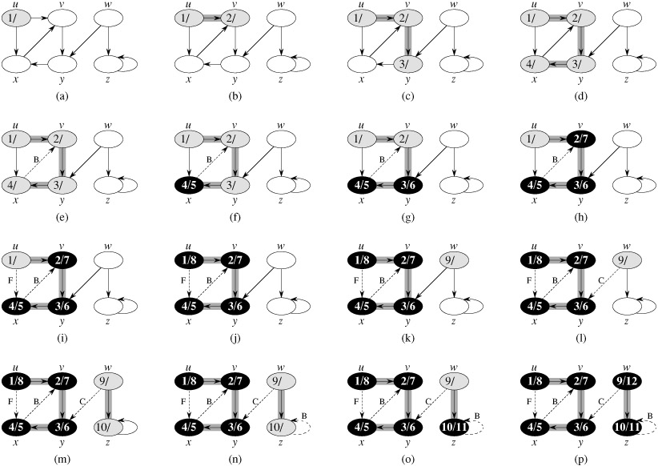
Depth first search – example

Slide 35
Depth first search - analysis
Lines 1-3, initialization take time O(V).
Lines 5-7 take time O(V), excluding the time to call the DFS-VISIT.
DFS-VISIT is called only once for each node (since it’s called only for white nodes and the first step in it is to paint the node gray).
Loop on line 4-7 is executed |Adj(v)| times. Since, ∑_{vєV} |Adj(v)| = O (E), the total cost of DFS-VISIT it O(E)
The total cost of DFS is O(V+E)

Slide 36
BFS and DFS - comparison
Space complexity of DFS is lower than that of BFS.
Time complexity of both is same – O(|V|+|E|).
The behavior differs for graphs where not all the vertices can be reached from the given vertex s.
In BFS- tree is formed
In DFS- forest is formed

Slide 37
DFS Example-2
source vertex

Slide 38
DFS Example
source vertex
d f
1 |
|
|
|
|
|
|
|

Slide 39
DFS Example
source vertex
d f
1 |
|
|
2 |
|
|
|
|

Slide 40
DFS Example
source vertex
d f
1 |
|
|
2 |
|
3 |
|
|

Slide 41
DFS Example
source vertex
d f
1 |
|
|
2 |
|
3 | 4
|
|

Slide 42
DFS Example
source vertex
d f
1 |
|
|
2 |
|
3 | 4
5 |
|

Slide 43
DFS Example
source vertex
d f
1 |
|
|
2 |
|
3 | 4
5 | 6
|

Slide 44
DFS Example
source vertex
d f
1 |
8 |
|
2 | 7
|
3 | 4
5 | 6
|

Slide 45
DFS Example
source vertex
d f
1 |
8 |
|
2 | 7
|
3 | 4
5 | 6
|

Slide 46
DFS Example
source vertex
d f
1 |
8 |
|
2 | 7
9 |
3 | 4
5 | 6
|

Slide 47
DFS Example
source vertex
d f
1 |
8 |
|
2 | 7
9 |10
3 | 4
5 | 6
|

Slide 48
DFS Example
source vertex
d f
1 |
8 |11
|
2 | 7
9 |10
3 | 4
5 | 6
|

Slide 49
DFS Example
source vertex
d f
1 |12
8 |11
|
2 | 7
9 |10
3 | 4
5 | 6
|

Slide 50
DFS Example
source vertex
d f
1 |12
8 |11
13|
2 | 7
9 |10
3 | 4
5 | 6
|

Slide 51
DFS Example
source vertex
d f
1 |12
8 |11
13|
2 | 7
9 |10
3 | 4
5 | 6
14|

Slide 52
DFS Example
source vertex
d f
1 |12
8 |11
13|
2 | 7
9 |10
3 | 4
5 | 6
14|15

Slide 53
DFS Example
source vertex
d f
1 |12
8 |11
13|16
2 | 7
9 |10
3 | 4
5 | 6
14|15

Slide 54
BFS and DFS – possible applications
Exploration algorithms in Artificial Intelligence
Possible to use in routing / exploration wherever travel is involved. E.g.,
I want to explore all the nearest pizza places and want to go to the nearest one with only two intersections.
Find distance from my factory to every delivery center.
Most of the mapping software (GOOGLE maps, YAHOO(?) maps) should be using these algorithms.
Companies like Waste Management, UPS and FedEx?
Applications of DFS
Topologically sorting a directed acyclic graph.
List the graph elements in such an order that all the nodes are listed before nodes to which they have outgoing edges.
Finding the strongly connected components of a directed graph.
List all the subgraphs of a strongly connected graph which themselves are strongly connected.

